Slide 1


DATA ANALYTICS PROJECT DEFENSE
Merson's Recruitment & Employee Attrition Analytics
Which hiring channels build a lasting, high-performing workforce, and why do employees leave?
Ayoola Enoch Ayo-oni
Wetin Dey Code Academy · September 2026
Notes:
Introduce yourself and the project: a Power BI analysis of recruitment sources and attrition at Merson.

Slide 2








WHAT WE WILL COVER
Outline
01
02
03
04
Introduction
Data Source & Overview
Objectives & Questions
Data Cleaning
05
06
07
08
Transformation & Analysis
Insights
Visualization
Conclusion & Recommendations

Slide 3






01 · INTRODUCTION
Introduction: Merson at a glance
A North American metals processing and manufacturing company serving customers across many industrial sectors through an extensive network of facilities.
Production
Engineering
Sales
Admin
Why this analysis?
To surface workforce patterns that support data-driven HR decisions on hiring channels and retention.
IT
Management

Slide 4
02 · DATA
Data Source & Overview
312
19
311
Data limitations
A snapshot from a specific period, so it may not reflect today
No recruitment cost or time-to-hire data
No qualitative detail behind each exit
Performance is categorical, not continuous
rows
columns
employee records analysed
Source: Kaggle.com HR dataset
Key fields
Salary
Position
Department
RecruitmentSource
PerformanceScore
EmploymentStatus
TermReason
EmpSatisfaction
DateofHire
DateofTermination
Absences
ManagerName

Slide 5
03 · OBJECTIVES
Objectives & Analysis Questions
Objectives
Analysis questions
1
Performance across recruitment sources
How do recruitment sources differ in performance, retention and satisfaction?
How does attrition vary across sources and departments?
What are the major termination reasons, and which are largest?
2
Attrition patterns by recruitment source
3
Reasons for termination and main drivers
4
Attrition levels by department
5
Retention, performance and satisfaction by source

Slide 6




04 · DATA CLEANING
Data Cleaning Process
STEP 1
STEP 2
STEP 3
STEP 4
Fix column headers
Blank detection
Duplicate check
Column labeling
EmpID → EmployeeId, DOB → DateofBirth, RaceDesc → Race, TermReason → TerminationReason
Checked with Find & Replace: no blank cells found
Remove Duplicates run: none found, none removed
Recoded M/F to Male/Female for clear labels

Slide 7
05 · TRANSFORMATION
Transformation: DAX Measures in Power BI
Cleaned data was imported into Power BI, where nine DAX measures drive every KPI and chart.
Total Employees
Active Employees
Terminated Employees
COUNT( )
COUNT( )
CALCULATE( )
Voluntary Terminations
Attrition Rate
Retention Rate
CALCULATE( )
DIVIDE( )
CALCULATE( )
Average Satisfaction
Exceeds Expectations
Exceeds Percentage
AVERAGE( )
CALCULATE( )
CALCULATE( )

Slide 8
INSIGHT · OBJECTIVE 1
Performance varies by recruitment source
20.7%
of Diversity Job Fair hires "Exceed Expectations"
Employee Referral is next at 16.1%
Indeed and LinkedIn, the biggest channels by volume, deliver below-average top performers
Google Search is lowest at 4.1%
Notes:
Share of hires rated Exceeds Expectations, by recruitment source.

Slide 9
INSIGHT · OBJECTIVE 2
Terminations concentrate in a few channels
30
terminations from Google Search, the highest of any source
Indeed (21) and LinkedIn (18) follow
Employee Referral lost only 5
Website, Online Web Application and Other lost 1 each

Slide 10
INSIGHT · OBJECTIVE 3
Why employees leave
59.6%
of all 104 exits come from the top five reasons
Another position (20), Unhappy (14), More money (11), Career change (9), Hours (8)
Mostly voluntary and preventable
Performance-related exits: only 4

Slide 11
INSIGHT · OBJECTIVE 4
Attrition peaks in two departments
39.7%
attrition rate in Production, the highest department
Software Engineering follows at 36.4%
Sales is lowest at 16.1%
Production is also 67% of all employees (209)

Slide 12
INSIGHT · OBJECTIVE 5
Retention differs sharply by recruitment source
92.3%
of Website hires are still active
Employee Referral 83.9%, LinkedIn 76.3%
Google Search 38.8% and Diversity Job Fair 44.8% are weakest
Online Web App is a single hire (0% active)

Slide 13
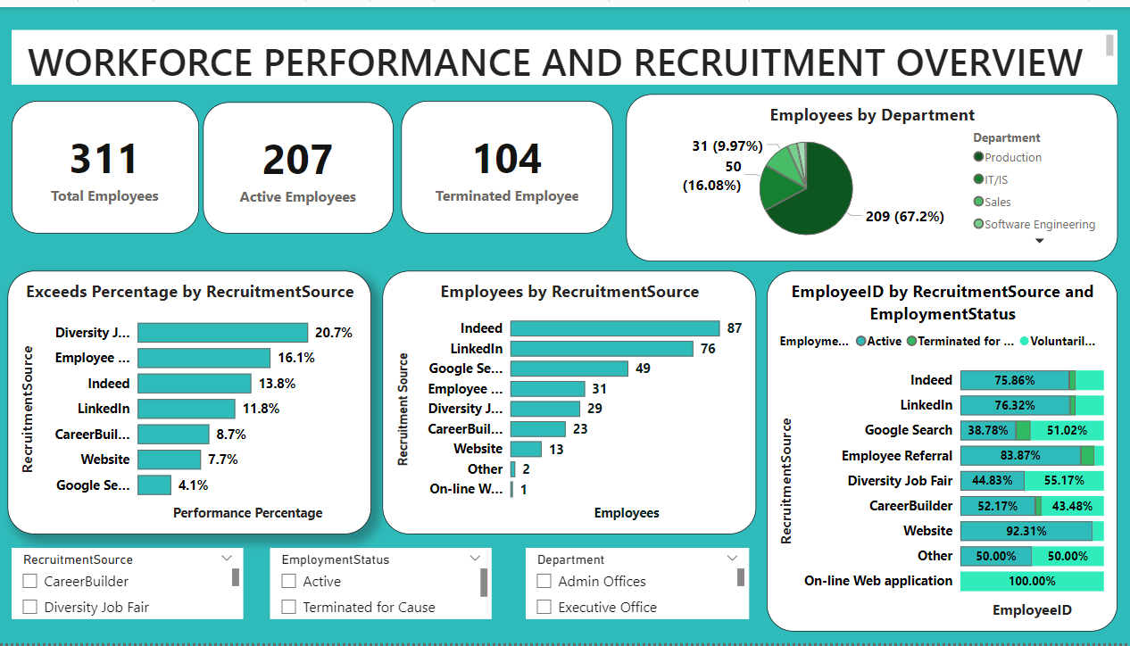
06 · VISUALIZATION
Workforce & Recruitment Overview Dashboard
311 total employees
207 active, 104 terminated
Production is 67.2% of the workforce
Indeed (87) and LinkedIn (76) lead hiring
Slicers filter by source, status and department

Slide 14
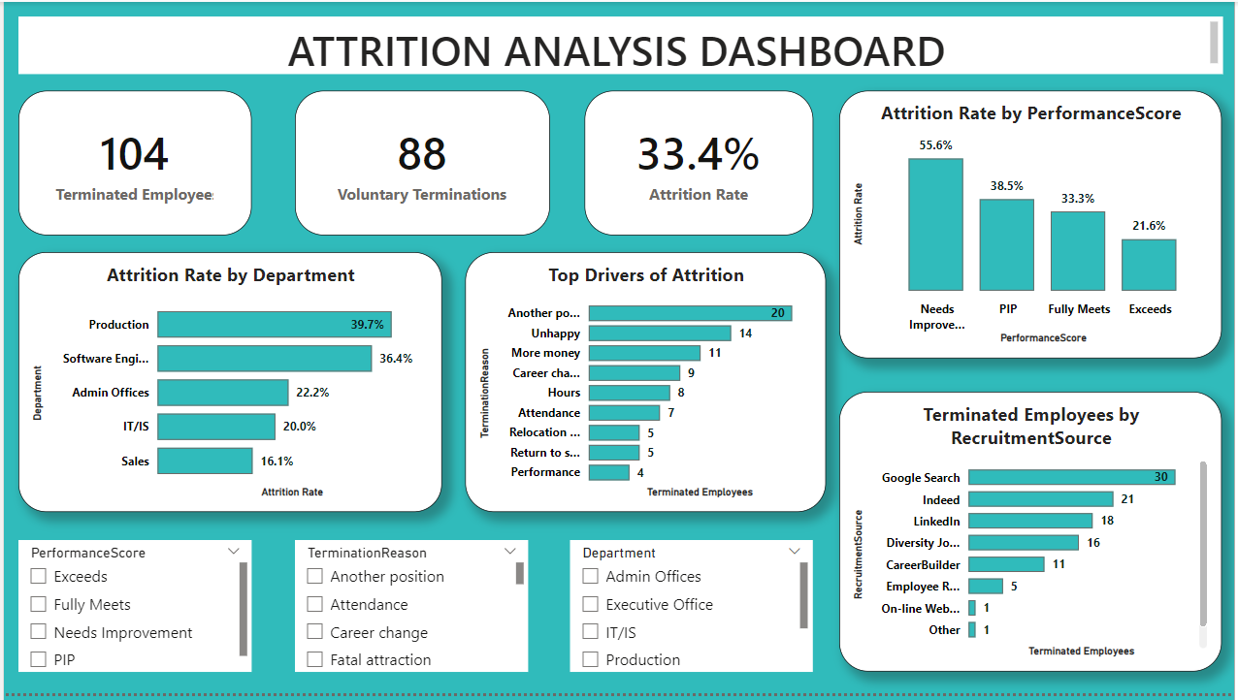
06 · VISUALIZATION
Attrition Analysis Dashboard
104 terminated, 88 voluntary
Attrition rate: 33.4%
Needs Improvement staff leave most (55.6%)
Exceeds performers leave least (21.6%)
Slicers filter by performance, reason and department

Slide 15
07 · CONCLUSION
Conclusion
33.4%
59.6%
>50%
104 of 311 employees were terminated
of exits explained by five largely voluntary reasons
of the workforce came via Indeed and LinkedIn
Attrition is not evenly spread: Production and Software Engineering, and channels like Google Search, drive most of it. Recruitment source, performance, department and employment status together shape workforce outcomes.

Slide 16





08 · RECOMMENDATIONS
Recommendations
Rebalance sourcing
Review weak channels
Target exit drivers
Keep Indeed and LinkedIn as core; shift budget toward Employee Referral and Website
Audit Google Search and Diversity Job Fair; focus on early-tenure onboarding
Strengthen engagement, career paths, pay reviews and exit interviews, starting in Production
Manage performance
Decide with outcomes
Coach low performers; recognise, develop and reward top performers
Use retention, performance and satisfaction in channel decisions

Slide 17




Thank you
Questions & discussion
ayoolaoni09@gmail.com
07036127122
linkedin.com/in/AyoolaAyooni
github.com/OAAlago

